Slide 1

Introduction
to
Web Development – II
(JavaScript)

Slide 2

Developed by: Brendan Eich
First released (in 1995)
by Netscape as LiveScript, later renamed as JavaScript
Further modifications was done by ECMA (European Computer Manufacturers Association)
Hence, JS is also known as ECMAScript
JavaScript

Slide 3
WHY THIS PPT…???
Only going through this PPT will make me PRO at JS…?
NO…!!!
This PPT is just for a reference of the important TOPICS that are going to be covered in the Workshop
The best way to learn JavaScript is to bang your head over the
CHROME CONSOLE

Slide 4
WHAT CAN JS DO ?
It can change the values of HTML attributes
- It can Show/Hide an HTML element
- It can change the styling of an HTML element
It can change the HTML content
It can define the functionality of a button
And also a lot of other cool stuffs…
First, we will discuss the basics of JavaScript,
And then we will learn about DOM (Document Object Model)

Slide 5
WHERE TO INCLUDE JS ?
Method-1:
In the HTML file itself, JS code is written inside the <script> tag
<script>
. . .
// Some code here
. . .
</script>
These scripts can be written either inside the head element or in the body element
Method-2:
JS can also be written in an EXTERNAL file with the extension .js
In this case, we need to provide the source of that external JavaScript file using the attribute src
<script src=“./my_external_file.js”>
NOTE:
A single HTML file can have more than one JS files / scripts

Slide 6
Output possibilities in JS?
Writing into an HTML element, using innerHTML
Writing into the HTML output, using document.write()
Writing into an alert box, using window.alert()
Writing into the browser console, using console.log()
NOTE:
console.log() is used mainly for DEBUGGING purposes
Writing document.write() after an HTML element is loaded will result in the deleting of the existing HTML.

Slide 7
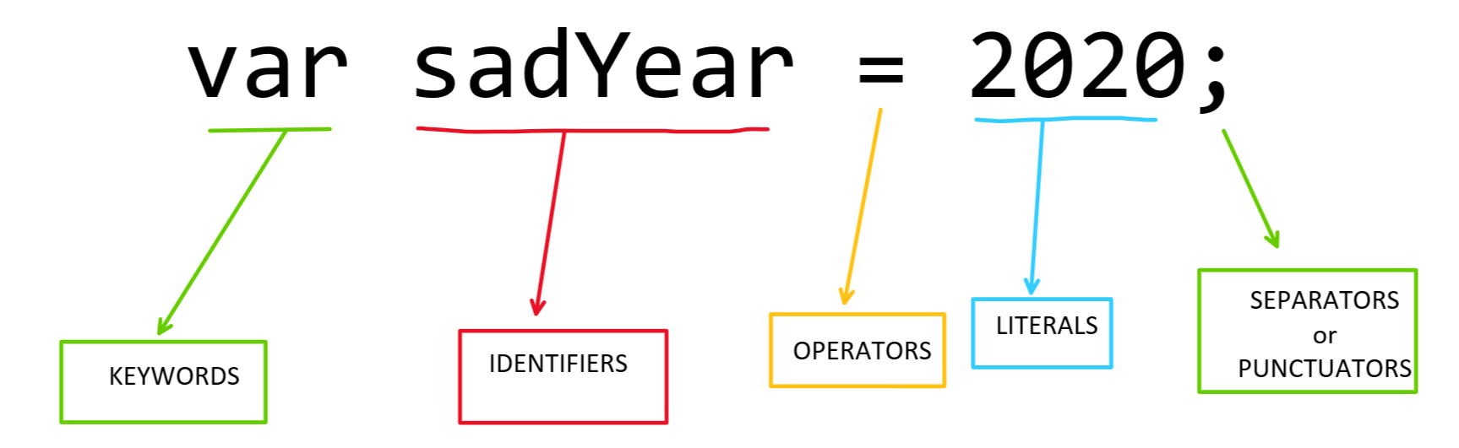
TOKENS: the fundamental building blocks in JS

Slide 8
SYNTAX : Set of Rules how programs are constructed
COMMENTS : Single (using forward slash // . . . ) and Multiline comments ( using /* . . . */ )
VALUES :
- VARIABLES
- LITERALS
names of the variables are called identifiers
Identifier naming rules:
- can include only letters, digits, underscore, and dollar sign
- must not begin with a digit
- is case-sensitive
Common naming styles: Camel case, and Pascal Case
OPERATORS : operate on variables and/or literals (called operands)
depending upon the type of operation:
ARITHMETIC OPERATOR + - * / % ++ --
ASSIGNMENT OPERATOR = += -= *= /= %=
RELATIONAL OPERATOR < > <= >= == === != !==
LOGICAL OPERATOR && || !
some other operators:
CONCAT STRING OPERATOR +
BITWISE OPERATOR | & ~ << >>
TERNARY OPERATOR ?
TYPE OPERATOR typeof instanceof

Slide 9
Variables in JS are declared using the var or let keywords
Constants are declared using the keyword const
var x; // Declaring the variable x
x = 90; // Initializing the variable to contain the contain a numerical value of 90
var y = 23.7; // Declaration and Initialization occurring in the same line
var z = (x + y)*2; // Declaring a variable z and initializing it with the outcome of an expression
var a;
console.log(a); → undefined
a = “IIT (ISM) Dhanbad”; → “IIT (ISM) Dhanbad”
console.log(b); → Uncaught ReferenceError: b is not defined
var fg = (x == y);
console.log(fg); → false

Slide 10
ARITHMETIC OPERATORS:
var x = 7;
var y = 3;
var z = x + y; // z = 10
var z = x - y ; // z = 4
var z = x * y; // z = 21
var z = x / y; // z = 2
var z = x % y; // z = 1
x++ ;
var z = x; // z = 8
y-- ;
var z = y; // z = 2;
var w1 = 5 + --y; // w1 = 5 + 1 = 6;
var w2 = 5 + x--; // w2 = 5 + 8 = 13;
x; // x = 7
Increment operation:
x++
++x
Decrement Operation:
x--
--x
Prefix operation:
--x
++x
Postfix Operation:
x--
x++

Slide 11
ASSIGNEMENT OPERATORS:
These are used for assigning value to javascript variables.
var x = 10 ; x +=5
x = ?? x = ??
x -= 5 ; x *= 5;
x = ?? x = ??
x /= 5; x%= 5;
x = ?? x = ??
var num = 100;
num += 7; // This is equivalent to writing : num = num + 7;

Slide 12
STRING CONCATENATION OPERATOR (+):
If one or both of the operands on either side of the arithmetic operator is a string:
Then,
+ will Concat the 2 operands.
* / - % will try to convert the string into a numerical value, and perform the respective arithmetic operation. If the value inside the quotes(“…”) is not a valid number, Then the result of arithmetic computation is NaN, which stands for “Not A Number”
PECULIARITY: typeof(NaN) is “number”
var a = 10;
var b = “Sand”;
var c = “200”;
var d = “30”;
var x1 = a + b; // z = “10Sand”
var x2 = a + c; // z = “10200”
var x3 = a - c; // z = -190
var x4 = c * d; // z = 6000
var x = a - b; // z = NaN

Slide 13
OPERATOR PRECEDENCE AND ASSICIATIVITY:
var x = ( 100 + 50) * 3 ;
x = ??
var x = 100 + 50 * 3;
x = ??
Here comes the use of precedence table which determines which operator should be operated first .
and * has higher precedence than +
P : Prefix postfix
A : Arithmetic
R : Relational Operator
L : Logical
A : Assignment Operator
Now, Among Arithmetic Operators:
+ - have a lower precedence than * / %
Arithmetic operators have an ASSOSIATIVITY from left to right…
var x = 9 - 10 + 5
x = ??
var x = 87 % 10 / 3
x = ??

Slide 14
Datatypes in JS?
DATATYPES in C, C++, Java ➔ The type of the variable. Variable of a particular datatype can store values of only that type
DATATYPE in JS ➔ The type of the value stored by the variable at any instant of time.
Broadly 2 categories: Primitive and Complex
1). PRIMITIVE DATATYPES:
- Numbers
- Strings
- Boolean
- Undefined
- Null
2). COMPLEX DATATYPES:
- Objects
- Functions
NOTE: JavaScript is loosely typed
Here variables are not dedicated to hold value of a particular datatype
That is the following code is legal:
var x = 45;
x = 78.9;
x = “Amarsh”;
x = true;
We can use the typeof operator to find the datatype of a:
- Value, or
- A variable (at any instant of time)

Slide 15
var x1 = 25; typeof x1; // “number”
var x2 = 78.90; typeof x2; // “number”
var x3 = 34e-3; typeof x3; // “number”
var y1 = true; typeof y1; // “boolean”
var y2 = false; typeof y2; // “boolean”
var z1 = “S”; typeof z1; // “string”
var z2 = “Sandeep Auddy755”; typeof z2; // “string”
var w1; typeof w1; // “undefined”
var w2 = undefined; typeof w2; // “undefined”
w3; // “undefined” typeof w3; // “undefined”
var point = {x: 78, y: 5, name:”my point”}; typeof point; // “object”
var arrs = [8, “Aman”, 90.7, true, 90]; typeof arrs; // “object”
function calcSum(a,b)
{
var sum = a + b;
console.log(“Sum of the 2 nos = ”+sum);
}
typeof calcSum; // “function”

Slide 16
Objects in JS?
These are variables too but can contain more than one value
In the form of KEY-VALUE pair
var car = {
type :"Fiat",
model: 500,
color:"white”,
isAffordable: false,
};
We can access these object properties in two ways :
objectName.PropertyName
objectName[“PropertyName”]
eg : car.type // returns Fiat
car["type"] // returns Fiat
car.model // returns 500
car["model"] // returns 500
NOTE:
The second method is useful when the KEY does not follow IDENTIFIER naming conventions
(eg: if there is a space in between)

Slide 17
Functions in JS?
A JavaScript function is a block of code used to design a particular task.
Syntax:
function name(parameter1, parameter2, parameter3)
{
code to be executed …
}
Example:
// Declaring a function
function myFunction(a, b)
{
return a * b;
}
// Calling/invoking a function
var x = myFunction(4, 3); // x = 12
… Variables store data values
… Whereas, Functions can store block of codes
A JS function may/may not have parameters
A JS function may/may not return a value
NOTE:
Unlike C, C++, JAVA;
JS functions don’t have a return type (ofc)

Slide 18
Functions as an object property
Objects apart from containing variables can also have function as their property;
and such functions are called methods.
A method can access the property of its own object using the this keyword .
var person = {
firstName : "Alex",
lastName : "Hunter",
id : 5566,
getFullName : function() {
console.log("My task is to return the full name");
nm = this.firstName + this.lastName;
return nm;
}
};
var name = person.getFullName();
name = ??

Slide 19
Arrays in JS?
Arrays are also a kind of object, but their they are generally indexed with a whole number
var seniors = [“Hritik” , “Aryan”, “Amarsh”, “Soumya”];
var x = Seniors[0]; // “Hritik”
var y = Seniors[2]; // “Amarsh”
typeof(seniors); // “object”
Arrays are specially useful when u need to iterate over some data values, and want to refer then using a single variable…
for(let i=0; i<4; i++)
{
console.log(“Hi!!...” + seniors[i]);
}
/*
Hi!!... Hritik
Hi!!... Aryan
Hi!!... Amarsh
Hi!!... Soumya
*/

Slide 20
More about Arrays in JS?
Unlike C, C++, JAVA; JS arrays need not be homogeneous…
var data = [“Hritik”, 2, true]; // Valid in JS
var year = data[1]; // 2
var isMem = data[0]; // “Hritik”
Arrays have a length property which stores the number of indexed elements in that array…
seniors.length; // 4
data.length; // 3
Arrays have some built-in functions:
var seniors = [“Hritik” , “Aryan”, “Amarsh”, “Soumya”];
seniors.sort();
// seniors = [“Amarsh”, “Aryan”, “Hritik”, “Soumya”]
seniors.push(“Abhishek”);
// seniors = [“Amarsh”, “Aryan”, “Hritik”, “Soumya”, “Abhishek”]

Slide 21
Strings in JS?
A JavaScript string is zero or more characters written inside quotes.
var club = “Cyber Labs”;
var n = club.length(); // 10
var ch1 = club.charAt(2); // “b”
var ch2 = club.charAt(23); // “”
var ch3 = club.charAt(-2); // “”
JS Strings have some some built-in functions associated with them
indexOf(“xyz”) : To find the starting index of the first occurrence of a given substring
lastIndexOf(“xyz”) : To find the starting index of the last occurrence of a given substring
slice(a, b) : To find a substring within the index range a(inclu.) to b(exclu.)
substr(a, len) : To find a substring starting at index a(inclu.) and having a length of len replace(“abc”, “xyz”) : To replace the 1st occurrence of “abc” with “xyz”
trim() : To remove white spaces on either side of the string
concat(“def”) : To concat the this string with “def”

Slide 22

DOM
Document Object Model

Slide 23
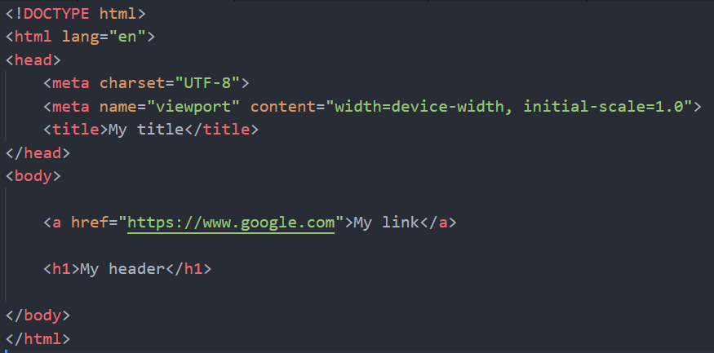
DOM
Document Object Model

Slide 24
Fundamental Technique:
1). SELECT
2). MANIPULATE

Slide 25
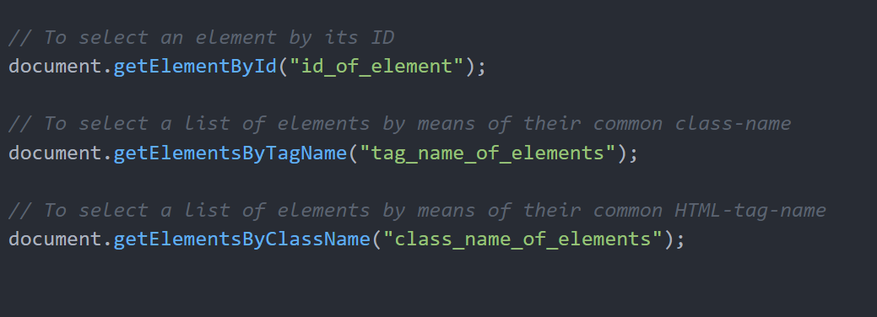
Various SELECTION techniques:

Slide 26
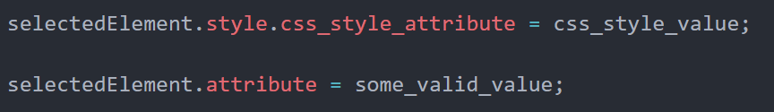
Some examples of MANIPULATION:
Change Styles
Add or Remove Classes
Change Content
Change Attribute
Adding or Removing Elements/ Children

Slide 27
DOM Events
A JavaScript code can be executed when an event occurs…
Like- when a user clicks on an HTML element, or when the value inside of a text field is changed
A detailed reference of the various DOM events can be found at:
https://www.w3schools.com/jsref/dom_obj_event.asp

Slide 28
console.log(“Thank You!”);

